Slide 1
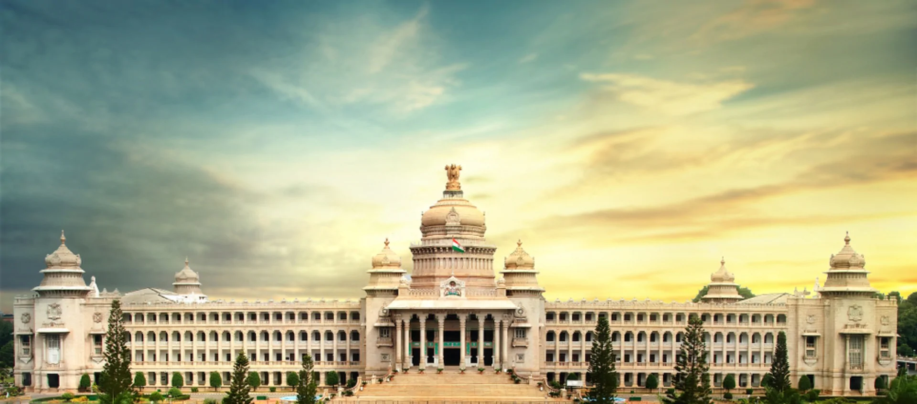
Battle of Neighborhoods
Bangalore Location Analysis: Setting up Hotel and Coffee Shop

Slide 2
Introduction: Business Problem
Bangalore (also known as Bengaluru) is one of the fastest growing cities in India and a major IT hub. Bangalore has witnessed phenomenal growth in the past several years and many businesses have thrived. This has attracted related and new businesses to the area. For a business to succeed in Bangalore, it is very important to set it up in a location where it can do well. The analysis performed in this project helps identify such locations.
Let us take two specific cases and analyze them in this project –
what is the ideal location for setting up a hotel?
what is the ideal location for setting up a coffee shop?
Data
Following data sources are used to extract and analyze the data:
Kaggle data source for Neighborhood data: publicly available Kaggle data source that captures Neighborhood in Bangalore, its longitude and latitude
Foursquare API: is used to extract location information by passing latitude and longitude of the various neighborhoods in Bangalore. Foursquare API provides a rich API to extract different venues in the neighborhood. This data is very important as it forms the basis of analysis for clustering.

Slide 3
Methodology
High-level methodology used for this project is provided below:
Both the data sets mentioned in section #2 are used to extract the nearby venues information for each of the neighborhoods in Bangalore
K-Means clustering is used to perform the analysis and determine the clusters.
Elbow method is used to find out the right “K” value. Optimal “k” value was determined to be “8” for this analysis.
Analysis
Venue data is carefully analyzed with help of bar graphs to visualize the neighborhoods and the number of nearby venues. There are several neighborhoods that have very minimal number of venues.
Results and Discussion
After clustering and segmenting following clusters have been created and analyzed graphically to identify the ideal locations to open:
Hotel
Coffee Shop

Slide 4
Conclusion
By carefully analyzing the clusters, we can conclude that:
Hotel
Only Cluster 3 has a hotel, so there is an opportunity to set up a hotel in other clusters Cluster 1, Cluster 2, Cluster 4, Cluster 5, Cluster 6, Cluster 7, and Cluster 8. Out of these clusters, only Cluster 7 and Cluster 2 have significant number of other attractions, making them ideal locations for setting up a hotel
Coffee Shop
There are no coffee shops in Cluster 1, Cluster 3, Cluster 5, Cluster 6 and Cluster 8, so they could be potential candidates for setting up a coffee shop. Out of them, Cluster 1 is best suitable for setting up a coffee shop because of the proximity to other attractions.
Find below the map listing the different clusters

